Slide 1



Predictive Modeling and Feature Analysis for Customer Churn in Consumer-Facing Industries
Group No: 07
Md. Fahim Shakil Chowdhury | 20210104128
Sanjana Akhter | 20210104150
Md. Mostafizur Rahman Rafid | 20210104151
📅 04 August 2025

Slide 2

Content
01
02
03
04
05
06
Overview
Our Contribution
Background Study
Model Diagram (Prototype of Methodology)
Gap Analysis
Conclusion
01

Slide 3


OVERVIEW

Slide 4





Overview
Our project aims to empower businesses with actionable insights to effectively reduce customer churn. By developing a predictive model using demographic, usage, and billing data, we seek to identify key churn indicators, evaluate various machine learning algorithms, and recommend strategies to enhance customer retention.
Predictive Accuracy
Precisely forecast customer churn using advanced machine learning models.
01
Feature Identification
Uncover the most influential factors driving customer attrition.
02
03
Retention Strategies
Develop data-driven, targeted interventions for enhanced customer loyalty.
Accuracy
Evaluate machine learning models for accuracy.
04
02

Slide 5
OUR CONTRIBUTION

Slide 6





OUR CONTRIBUTION
Our project encompasses a robust methodology from raw data to actionable insights.
Data Preparation
Exploratory Data Analysis (EDA)
Feature Engineering
Rigorous cleaning, transformation, and validation of raw customer data from sources like Kaggle to ensure quality and consistency for model training.
Exploratory Data Analysis (EDA)
In-depth statistical and visual analysis to uncover patterns, correlations, and anomalies within the dataset, providing foundational insights into customer behavior.
Feature Engineering
Creation of new, more informative features from existing data, enhancing the predictive power and interpretability of our models.
03

Slide 7

OUR CONTRIBUTION
Our project encompasses a robust methodology from raw data to actionable insights.
Model Implementation
Model Evaluation
Comprehensive assessment of model performance using various metrics (accuracy, precision, recall, F1-score) to ensure reliability and generalization.
Selection and training of appropriate machine learning algorithms (e.g., Random Forest, XGBoost) on the prepared dataset to build robust predictive models.
04

Slide 8
BACKGROUND STUDY

Slide 9


Background Study
01
Multiple studies analyzed customer churn prediction using telecom and financial datasets with various machine learning models.
02
Logistic Regression and Random Forest often performed well, with XGBoost showing top AUC scores (up to 93.3%).
03
Feature engineering, preprocessing, and handling class imbalance were key to boosting model performance.
04
Explainable AI tools like SHAP and LIME improved model interpretability and business relevance.
05
Deep learning and causal analysis offered predictive power and strategic insights to reduce churn and improve customer retention.
05

Slide 10
MODEL DIAGRAM

Slide 11
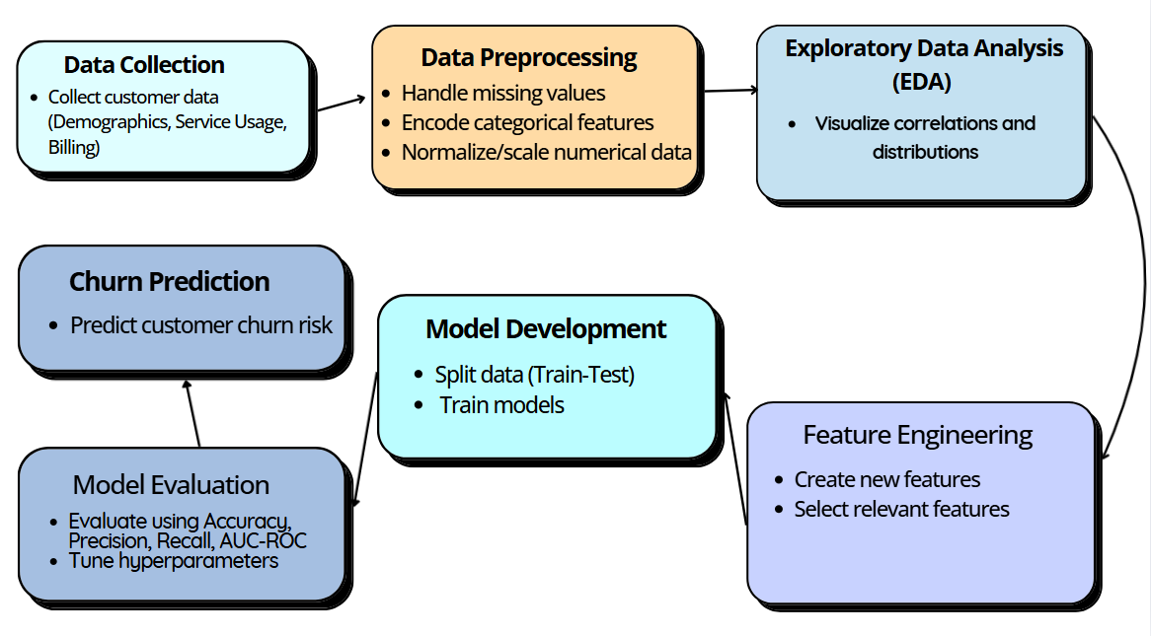
Model Diagram
.
06

Slide 12
GAP ANALYSIS

Slide 13
GAP ANALYSIS
Our project encompasses a robust methodology from raw data to actionable insights.
Advance Feature Engineering
Balancing Accuracy and Interpretability
Most churn models rely on basic data, overlooking the potential of engineered features. This project aims to build and test new predictors to boost model accuracy.
While black-box models like XGBoost offer high accuracy, they’re hard to interpret. Our goal is to translate complex model outputs into clear, actionable business strategies—even if it means trading some accuracy for usability.
07

Slide 14
CONCLUSION

Slide 15




ML as the Standard
Machine learning is the established and reliable standard for predicting customer churn, offering unparalleled analytical depth.
High Accuracy Models
Conclusion
Models like Random Forest and XGBoost consistently deliver high predictive accuracy, proving effective in diverse datasets.
Our findings affirm the robust capabilities of machine learning in churn prediction.
Data Preprocessing is Key
Rigorous data preprocessing is a critical and mandatory step for success, directly impacting model performance and reliability.
Interpretability for Action
Model interpretability is essential for creating trustworthy and actionable business insights, enabling targeted retention strategies.
08

Slide 16
TEAM MEMBERS

Slide 17




Team
Md. Fahim Shakil Chowdhury
ID No: 20210104128
Sanjana Akhter
ID No: 20210104150
Md. Mostafizur Rahman Rafid
ID No: 20210104151
09

Slide 18
THANK YOU
10

